Slide 1
Air Quality Prediction
Domain : Machine Learning, IoT,
Android & Web Application
Team : Tech Squad
ArunBalaji S
Deekshitha I S
Dharshini P G
Neelashkumar P

Slide 2
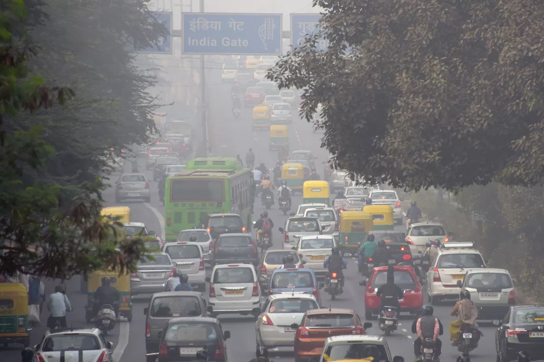
Outline
Problem Statement
Objective
Existing System
Proposed System
Data Analysis
Data Modelling
Air Quality Index
Benefits

Slide 3
Problem Statement
Air pollution is a global environmental problem that influences mostly health of urban population
Traditional air quality monitoring methods such as building an air quality monitoring stations are typically expensive

Slide 4
Objective
To offer scientific analysis of pollution data to predict the level of ozone using machine learning models
To monitor meteorological data using IoT
To implement the model through Android and Web application

Slide 5

Proposed System

Slide 6
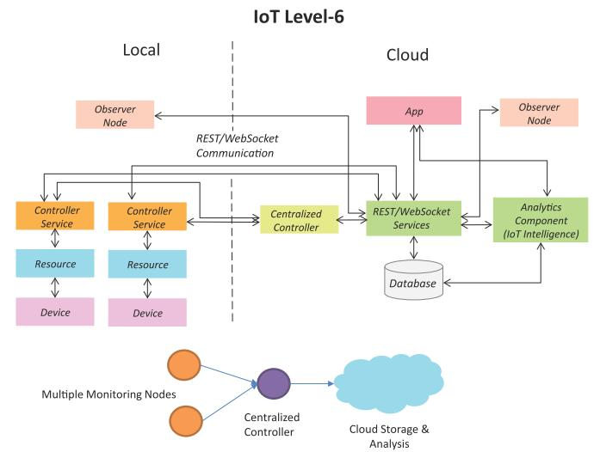
Data Collection Using IoT

Slide 7
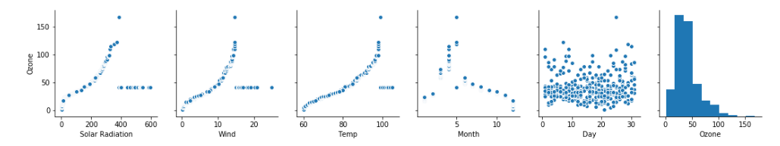
Data Analysis
Pair Plot

Slide 8
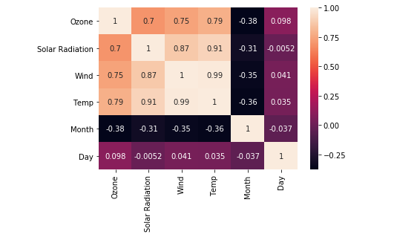
Data Analysis
Heat Map

Slide 9

Data Modelling
Random Forest Regression
It is a type of additive model that makes predictions by combining decisions from a sequence of base models (Ensemble Technique).
where the final model g is the sum of simple base models f_{i} .

Slide 10
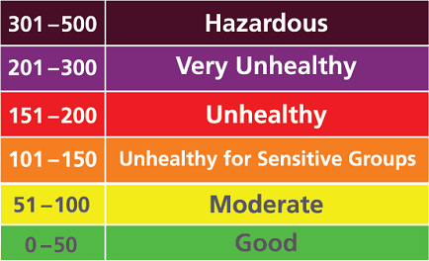
Air Quality Index Vs Ozone

Slide 11
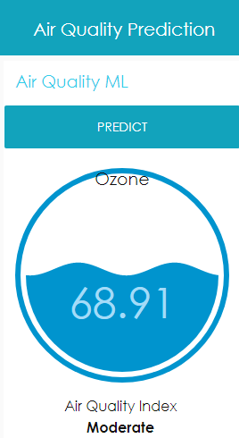
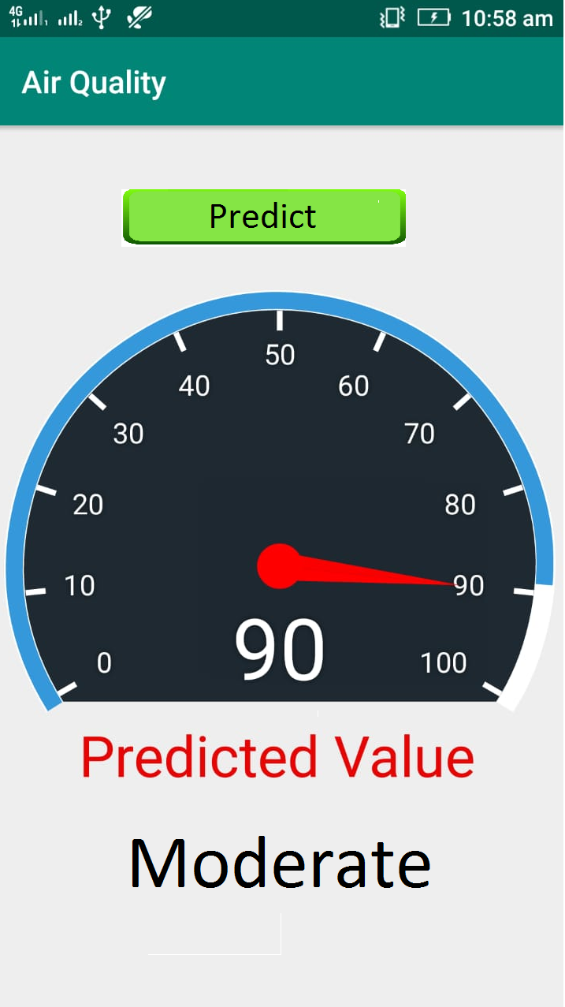

Slide 12
Benefits
The data collected help us assess impacts caused by poor air quality on public health
Identify polluted areas, the level of pollution and air quality level.
Improve understanding of the potential impact of industrial development and unregulated activities.
Support state-level air quality programs and longer range planning and priority setting.

Slide 13



